Slide 1
Consciousness: Sleep, Dreams, Hypnosis, and Drugs
Chapter 4

Slide 2
What is Consciousness?
Consciousness is a concept that most people think they understand until someone asks them to define it
Consciousness – a person’s awareness of everything that is going on around him or her at any given moment, which is used to organize behavior
Includes thoughts, sensations, and feelings
Cognitive neuroscience view – consciousness is generated by a set of action potentials in the communication among neurons just sufficient to produce a specific perception, memory, or experience in our awareness
Ex. your eyes see a dog, then the neurons along the optic pathway to the occipital lobe’s visual cortex are activated, and the visual association cortex is activated to identify the external stimulus as a “dog”… and BAM!!! You have consciousness
Most of the time we are awake we are in a state called waking consciousness (thoughts, feelings, and sensations are clear and organized, and we feel alert)
But there are many times during the day and in life when people experience states of consciousness that differ from the organized waking state called “altered states of consciousness”

Slide 3
Altered States of Consciousness
Altered state of consciousness – occurs when there is a shift in the quality or pattern of you mental activity
Thoughts may become fuzzy and disorganized and you may feel less alert, or your thoughts may take bizarre turns, as they often do in dreams
Sometimes an altered state may mean being in a state of increased awareness, as when under the influence of a stimulant
You also may divide you conscious awareness
Ex. Like when you drive to school or work and wonder how you got there
One level of conscious awareness was driving, while the other was thinking about the day ahead, perhaps (actually called driving hypnosis)
Altered state of divided conscious awareness can be dangerous
Ex. Talking on a cell phone while driving, both driving and carrying on a conversation should require full focus of attention to be done safely
Studies have shown that driving while talking on a cell phone (even the hands free versions) puts people at the same degree of risk as driving under the influence of alcohol

Slide 4
Altered States of Consciousness
There are many forms of altered states of consciousness
Ex. Daydreaming, being hypnotized, or achieving a meditative state
Being under the influence of certain drugs such as caffeine, tobacco, or alcohol are all examples of altered states
In recent years, there has been a definite rise in the use of stimulants and memory-enhancing drugs to boost cognitive performance in adults
But the most common altered state people experience is sleep

Slide 5
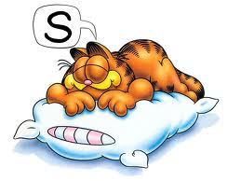
Altered States: The Biology of Sleep
People can try to stay awake, and sometimes they may go for a while without sleep, but eventually they must sleep
One reason for this is that sleep is one of the body’s biological rhythms, natural cycles of activity that the body must go through
Some rhythms are monthly (ex. cycle of a woman’s menstruation) and some are far shorter (ex. heart beat)
But many biological rhythms occur on a daily basis, like the rise and fall of blood pressure and body temperature or the production of certain body chemicals
The sleep-wake cycle is a circadian rhythm
Circadian rhythm – a cycle of bodily rhythm that occurs over a 24-hour period
For most people, this means that they will experience several hours of sleep at least once during every 24-hour period
The sleep-wake cycle is ultimately controlled by the brain, specifically by an area within the hypothalamus

Slide 6
The Biology of Sleep: Melatonin
Melatonin is a hormone secreted by the pineal gland, and when it accumulates in the body, it makes people feel sleepy
The release of melatonin is influenced by a structure deep within the hypothalamus in an area called the suprachiasmatic nucleus (SCN), the internal clock that tells people when to wake up and when to fall asleep
As daylight fades, the SCN tells the pineal gland (located at the base of the brain) to secrete melatonin
As melatonin accumulates, a person will feel sleepy
As the light coming into the eyes increases (as it does in the morning), the SCN tells the pineal gland to stop secreting melatonin, allowing the body to awaken
This is why you can sleep in much later if you are in a very dark room (with no windows or the windows are covered)

Slide 7
The Biology of Sleep: Melatonin
Melatonin supplements are often used to treat jet lag (when the body’s circadian rhythm is disrupted by traveling to another time zone)
Melatonin supplements may also help people who suffer from sleep problems due to shift work
Shift-work sleep problems are often caused when workers change shifts against their natural circadian rhythm (ex. From a day shift to a night shift, and then back again to an evening shift)

Slide 8
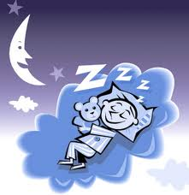
The Biology of Sleep
In addition to the role of melatonin, there is ongoing research into the role of the neurotransmitter serotonin in the regulation of sleep
As the day goes by, serotonin levels in the nervous system increase and seem to be associated with sleepiness
This would explain why it’s hard for people to stay awake after their usual bedtime, the serotonin level may be high enough at that time to produce an intense feeling of sleepiness
Body temperature also plays a role in inducing sleep
The SCN, as part of the hypothalamus, controls body temperature
The higher the body temperature, the more alert people are and the lower the temperature the sleepier they are
When people are asleep at night their body temperature is at its lowest level
But! The research on the roles of serotonin and body temperature is only correlational at this point, thus, we cannot infer that either of these 2 things actually causes sleep, just that they are related

Slide 9
The Biology of Sleep: Research
Research has been conducted on the effects of lack of information about day and night on the sleep-wake cycle
In these studies, volunteers spend several days without access to information about day or night
What happens is their sleep-wake cycles lengthen from 24 hours to 25 hours
Including daily activities such as sleeping, waking, waste production, blood pressure rise and fall, hormone secretion, and so on…
Based on this research, in appears that the SCN may be responsible for resetting the body’s biological “clock” to a 24-hour cycle every day
In the same studies, body temperature dropped consistently even in the absence of light
As body temperature dropped, sleep began, giving further support to the importance of body temperature in the regulation of sleep

Slide 10
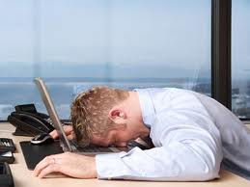
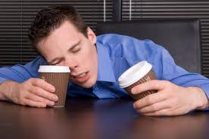
Biology of Sleep: The Price of Not Sleeping
Although people can do without sleep for a little while, they cannot do without it altogether
In one study, rats were placed on moving treadmills over water. They couldn’t sleep because they would fall into the water and be awakened, but they did drift repeatedly into microsleeps
Microsleeps – brief sidesteps into sleep lasting only a few seconds
People can have microsleeps too
Microsleeps are responsible for a lot of car accidents that occur when people have had very little sleep
What happens when a person misses a night of sleep?
For most people, missing a night of sleep will result in concentration problems and the inability to do simple tasks (like putting a CD into a player)
More complex tasks, such as math problems, suffer less than simple tasks because people know they must concentrate on complex tasks

Slide 11
Biology of Sleep: The Price of Not Sleeping
Sleep deprivation (loss of sleep) is a serious problem that many people have without realizing it
People stay up too late at night during the week, get up before they’ve really rested to go to work or school, and then try to pay off the “sleep debt” on the weekend
All of that disrupts the normal sleep-wake cycle and isn’t good for anyone’s health
Ex. Students may stay up all night to study for an important test the next day. In doing so, they will lose more information than they gain, as a good night’s sleep is important for memory and the ability to think well
Typical symptoms of sleep deprivation include: trembling hands, inattention, staring off into space, droopy eyelids, and general discomfort, as well as emotional symptoms such as irritability and even depression

Slide 12
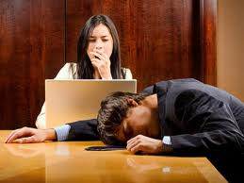
Biology of Sleep: The Price of Not Sleeping
Sleep researchers conducted a study in which healthy adults between the ages of 21 and 38 were randomly placed in one of 4 restricted sleep conditions
Participants began the experiment with at least 3 days of regular sleep and then were allowed to get only 4 hours, 6 hours, or 8 hours (control group) of sleep for 14 days. A 4th group of participants were totally deprived of sleep for 3 days in a row (kept awake by the researchers)
Measurements of the participants’ cognitive abilities and physical alertness were taken every 2 hours during scheduled “awake times”
Results
Even in the 6-hour sleep condition, participants’ abilities to function mentally and physically were as negatively affected as if they had been entirely deprived of sleep for 2 nights in a row
All participants in the sleep-deprived and no-sleep conditions were seriously impaired in their functioning and were relatively unaware of the seriousness of the impairment
Fact that participants did not seem to be aware of their problems in functioning may account for the impression many people have that a few nights of poor sleep are not that serious
The results of this study seems to indicate that even moderate sleep loss is a serious problem

Slide 13
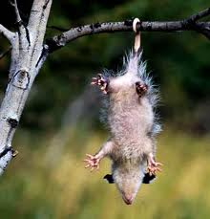
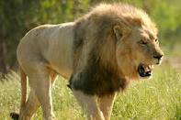
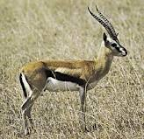
Theories About Sleep: Why do we need it?
The adaptive theory of sleep – views sleep as a product of evolution
Proposes that animals and humans evolved different sleep patterns to avoid being present during their predators’ normal hunting times, which typically would be at night
Ex. If a human or a prey animal is out and about at night, they are more at risk of being eaten, but, if during active hunting hours the prey is in a safe place sleeping and conserving energy, it is more likely to remain unharmed
If this theory is true, then one would expect prey animals to sleep mostly at night and for shorter periods of time than predator animals; you would also expect that predators could sleep in the day time as much as they want
This seems to be the case for predators like lions that have very few natural predators. Lions sleep nearly 15 hours a day, whereas their prey animals, like gazelles, sleep only 4 hours a day, usually in short naps.
Nocturnal animals, such as the opossum, can afford to sleep during the day and be active at night (when their food sources are available), because they are protected from predators by sleeping high up in trees

Slide 14
Theories About Sleep: Why do we need it?
The restorative theory of sleep – sleep is necessary for the physical health of the body
During sleep, chemicals that were used up during the day’s activities are replenished and cellular damage is repaired
There is evidence that most bodily growth and repair occur during the deepest stages of sleep, when enzymes responsible for these functions are secreted in higher amounts
So which theory is correct?
Both are probably needed to understand why sleep occurs the way it does
Adaptive theory explains why people sleep when they do
Restorative theory explains why people need to sleep

Slide 15
How Much Sleep Do People Need?
The answer varies from person to person because of each person’s age and possibly inherited sleep needs
Most young adults need about 7 to 9 hours of sleep per 24 hours in order to function well
Some people are short sleepers, needing only 4 or 5 hours
And others are long sleepers and require more than 9 hours
As we age, we seem to sleep less during each night until the average length of sleep approaches only 6 hours
So we actually need more sleep when we are younger and less when we are older… maybe that’s why most young people can sleep till noon but grandparents always seem to be up very early in the morning

Slide 16
The Stages of Sleep
There are actually 2 kinds of sleep
REM (rapid eye movement) – active type of sleep when the eyes move rapidly under the eye lids and when most of a persons dreaming takes place
The voluntary muscles are inhibited, meaning that the person in REM sleep moves very little
NREM (non-rapid eye movement) – any of the stages of sleep that don’t include REM
Body is free to move around
There are several different stages of sleep that people go through each night in which REM and NREM occur
A person who is awake and mentally active displays a brain-wave pattern known as beta waves (very small and very fast)
As a person relaxes and gets drowsy, slightly larger and slower alpha waves appear
Alpha waves are eventually replaced by even slower and larger theta waves, which indicate the early stages of sleep

Slide 17
Stages of Sleep: NREM Stage 1, Light Sleep
Theta wave activity increases and alpha wave activity fades away
If people are awakened at this point, they probably wont believe they were actually asleep
People may experience vivid visual events called hypnogogic images or hallucinations
Many researchers now believe that peoples’ experiences of ghostly visits, alien abductions, and near-death experiences may be most easily explained by these hallucinations
Much more common occurrence is called the hypnic jerk
When you are drifting off to sleep when your knees, legs, or sometimes your whole body gives a big “jerk”
No solid proof of why this occurs, but many believe it has something to do with the possibility that our ancestors slept in trees: the relaxation of the muscles as one drifts into sleep causes a “falling” sensation, at which point the body jerks to awake to prevent the “fall” from the hypothetical tree

Slide 18
Stages of Sleep: NREM Stage 2, Sleep Spindles
As people drift further into sleep, the body temperature continues to drop, heart rate slows, breathing becomes more shallow and irregular, and sleep spindles begin to occur
Sleep spindles – brief bursts of activity in the brain lasting only a second or two
Theta waves still predominate in this stage
But if people are awakened during this stage, they will be aware of having been asleep

Slide 19
Stages of Sleep: NREM Stages 3 & 4, Delta Waves Roll In
Delta waves – the slowest and largest waves
In stage 3 delta waves make up only about 20-50% of the brain-wave pattern
Stage 4 occurs when delta waves make up over 50% of the total brain-wave activity
Deepest stage of sleep
Growth hormones are released from the pituitary gland and reach their peak
Body is at its lowest level of functioning
Eventually, the delta waves become the dominant brain activity for this stage

Slide 20
Sleep Stage 4
People in deep sleep are very hard to awaken
If something does wake them they may be very confused and disoriented
Children are even harder to wake up when in this state than are adults
Deep sleep is the time when body growth occurs
This may explain why children in periods of rapid growth need to sleep more and also helps explain why children who are experiencing disrupted sleep suffer delays in growth
The fact that children do sleep so deeply may explain why certain sleep disorders are more common in childhood
Many sleep disorders are more common in boys than in girls because boys sleep more deeply than do girls due to high levels of the male hormone testosterone

Slide 21
What Happens in REM Sleep?
After stage 4, a sleeping person will go back up through stage 3, stage 2
Then into a stage in which body temperature increases to near waking levels, the eyes move rapidly under the eyelids, the heart beats much faster, and brain waves resemble beta waves
The person is still asleep but in REM
If a person is awakened during REM sleep, he/she almost always reports being in a dream state
90% of dreams take place during REM
People do have dreams in other NREM stages, but REM dreams tend to be more vivid, more detailed, longer, and more bizarre than NREM dreams
REM paralysis – the body is unable to act upon these dreams under normal conditions because the voluntary muscles are paralyzed during REM sleep
This is why you sometimes have a dream in which you are trying to run or move, and can’t, you are partially aware of REM paralysis

Slide 22
The Need for REM Sleep
REM sleep seems to serve a different purpose than NREM
After a very physically demanding day people tend to spend more time in NREM, or deep sleep
After an emotionally stressful day people spend increased time in REM sleep
Perhaps REM dreams are a way of dealing with the stresses and tensions of the day and physical activity demands more time for recovery of the body in NREM
If deprived of REM sleep (as occurs with the use of sleeping pills or other depressant drugs) a person will experience greatly increased amounts of REM sleep the next night, a phenomenon called REM rebound
REM rebound – increased amounts of REM sleep after being deprived of REM sleep on earlier nights

Slide 23
The Need for REM Sleep
REM sleep in early infancy differs from adult REM sleep
Babies spend nearly 50% of their sleep in REM versus 20% for adults
Infants’ brain-wave patterns during REM sleep are different than adults’
Infants can and do move around during REM sleep and adults cannot
Explanation: when infants are engaged in REM sleep, they are not dreaming but rather forming new connections between neurons
The infant brain is highly plastic, and much of brain growth and development takes place during REM sleep
As the infant’s brain nears its adult size by age 5 or 6, the proportion of REM sleep also decreases to a more adultlike ratio of REM to NREM

Slide 24
Sleep Disorders: Nightmares & REM Behavior Disorder
Nightmares – bad dreams occurring during REM sleep
Children tend to have more nightmares than adults because they spend more of their sleep in the REM state
As children age, they have fewer nightmares because they have less opportunity to have them
REM behavior disorder – rare disorder in which the mechanism that blocks the movement of the voluntary muscles fails, allowing the person to thrash around and even get up at act out nightmares
Usually seen in men over age 60, but can also occur in younger men and women

Slide 25
REM Behavior Disorder is Serious
Case 1:1987 in Toronto Canada, a 23 year old man named Kenneth Parks got up early in the morning, drove 14 miles to his wife’s parent’s house, stabbed his mother-in-law to death and attacked his father-in-law. He then drove to the police station and told officers that he thought he had killed some people.
Kenneth had been suffering from severe insomnia and had a history or sleepwalking
Sleep experts and psychiatrists concluded that he was indeed unaware of his actions at the time of the crime and he was acquitted

Slide 26
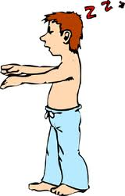
Stage 4 Sleep Disorders
Sleepwalking (somnambulism) – occurring during deep sleep, an episode of moving around or walking around in one’s sleep
Occurs in about 20% of the population
At least partially due to heredity
More common in childhood and is more common in boys than girls
Can include activities from simply sitting up in the bed to walking around the home
Most grow out of sleepwalking in adolescence

Slide 27
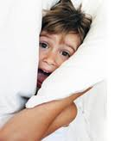
Night Terrors
A rare disorder in which the person experiences extreme fear and screams or runs around during deep sleep without waking fully
More likely in children, and also likely to disappear as the child gets older
It is not uncommon for people to feel like they are unable to breath while they are in this state
Given that they are in a very deep sleep and breathing shallowly to begin with
Main differences between nightmares and night terrors has to do with the stage of sleep during which they occur
Night terrors occur during deep sleep NREM, when the body is not engaged in REM paralysis, thus people may get up and move around during night terrors. Also, night terrors are rarely ever remembered
Nightmares occur during REM sleep, thus people are usually unable to move during nightmares and frequently are able to remember them

Slide 28
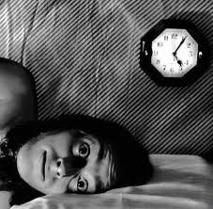
Insomnia
The inability to get to sleep, stay asleep, or get a good quality of sleep
Psychological causes
Worrying, trying too hard to sleep, anxiety
Physiological causes
Too much caffeine, indigestion, aches and pains
Steps to avoid insomnia
Go to bed only when you are sleepy
Don’t do anything in your bed but sleep
Don’t try to hard to get to sleep
Keep to a regular schedule
Don’t take sleeping pills or drink alcohol or other types of drugs that slow down the nervous system

Slide 29
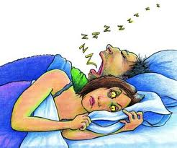
Sleep Apnea
A disorder in which the person stops breathing for nearly half a minute or more
When breathing stops, there is a sudden silence, followed by a gasping sound as the person struggles to get air into the lungs
Many people do not wake up while this is happening, but they don’t get a good night’s sleep
Apnea can cause heart problems
Obesity is a primary cause
Treatments
Wearing a device on the nose at night to open the airway
Sprays that are used to shrink the tissues lining the throat
Weight loss
Sleeping with a device that delivers a continuous stream of air under mild pressure called a continuous positive airway pressure (CPAP) devices
Surgery to remove the uvula and soft tissues around it
Some very young infants also experience a kind of apnea due to immaturity of the brain stem
These infants are typically placed on monitors that sound an alarm when breathing stops, allowing caregivers to help the infant begin breathing again

Slide 30
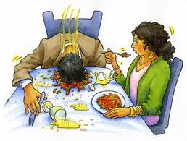
Narcolepsy
A disorder in which a person falls immediately into REM sleep during the day without warning
Effects 1 in every 2,000 people
Attacks are more likely to occur when the person is experiencing strong emotions
Operation of a car or other machinery is very dangerous
Sudden REM attacks are especially dangerous because of cataplexy (sudden loss of muscle tone)
This REM paralysis may cause injuries if the person is standing when the attack occurs
The same hypnogogic images that occur during stage 1 sleep may also occur in the narcoleptic person

Slide 31
Disorder | Primary Symptoms
Somnambulism (Sleepwalking) | Sitting, walking or performing complex behavior while asleep
Night terrors | Extreme fear, agitation, screaming while asleep
Restless leg syndrome | Uncomfortable sensations in legs causing movement and loss of sleep
Nocturnal leg cramps | Painful cramps in calf or foot muscles
Hypersomnia | Excessive daytime sleepiness
Circadian rhythm disorders | Disturbances of the sleep-wake cycle such as jet lag and shift work
Enuresis | Urinating while asleep in bed

Slide 32
Freud’s Interpretation of Dreams: Dreams as Wish Fulfillment
Believed his patients’ problems stemmed from conflicts and events that had been buried in their unconscious minds since childhood
These early traumas were seen as the cause of behavior problems in adulthood
One of the ways Freud believed he could analyze these early memories was to examine the dreams of his patients
Because he believed that conflicts, events, and desires of the past would be represented in symbolic forms in the dreams

Slide 33
Freud’s Interpretation of Dreams: Dreams as Wish Fulfillment
The manifest content of a dream is the actual dream itself
Ex. If you have a dream about climbing out of the bathtub, the manifest content is exactly that, trying to climb out of a bathtub
The latent content of a dream is its underlying or latent meaning and is only expressed in symbols
Ex. In the dream about climbing out of the bathtub, Freud might say that the water in the bathtub might symbolize the waters of birth and the tub might symbolize your mother’s womb, so, according to Freud you could be dreaming about being born
Today, Freud’s dream analysis is dismissed by most psychologists
But there are still some people who insist that dreams have symbolic meaning

Slide 34
The Activation-Synthesis Hypothesis
Using brain-imaging techniques researchers have found evidence that dreams are products of activity in the pons
The pons is a lower area of the brain that inhibits the neurotransmitters that would allow movement of the voluntary muscles while sending random signals to the areas of the cortex that interpret vision, hearing, etc.
When signals from the pons bombard the cortex during waking consciousness, the association areas of the cortex interpret those signals as seeing and hearing.
Because those signals come from the real world, this process results in an experience of reality
But, when people are asleep, the signals from the brain stem are random and not necessarily attached to actual external stimuli
The brain must somehow interpret these random signals, so it puts together, or synthesizes, an explanation of the cortex’s activation from memories and other stored information

Slide 35
The Activation-Synthesis Hypothesis
In this theory, a dream is only another kind of thinking that occurs when people sleep
Dreams are less realistic than thinking that occurs during waking because it doesn’t come from reality
It comes from people’s memories and past experiences
The frontal lobes, which people normally use in daytime thinking, are shut down during dreaming, which may also account for the unrealistic and often bizarre nature of dreams
Some dream experts have suggested that dreams have more meaning than the Activation-Synthesis Hypothesis suggests
Thus, it has been reworked into the activation-information-mode model or AIM, which includes concerns about dream meaning
In this version, information that is accessed during waking hours can influence the synthesis of dreams
In other words, when the brain is “making up” a dream to explain its own activation, it uses meaningful bits and pieces of the person’s recent experiences, rather than just random items from memory

Slide 36
What do people dream about?
Information collected on over 10,000 dreams revealed that most dreams reflect the events that occur in everyday life
There are gender differences in dream content which are true across many cultures
The cause of these differences remains unknown
Men
More often dream of other males
Tend to have more physical aggression in their dreams
Tend to have dreams that take place outdoors or in unfamiliar settings and may involve weapons, tools, cars, and roads
More sexual dreams, usually with unknown and attractive partners
Women
Tend to dream about males and females equally
More often tend to be the victims of aggression in their dreams
Tend to dream about people they know, personal appearance concerns, and issues related to family and home

Slide 37
Altered States: The Effects of Hypnosis
Hypnosis – state of consciousness in which the person is especially susceptible to suggestion
There are several key steps in inducing hypnosis
They hypnotist tells the person to focus on what is being said
The person is told to relax and feel tired
The hypnotist tells the person to “let go” and accept suggestions easily
The person is told to use vivid imagination
Key to hypnosis seems to be a heightened state of suggestibility
People can be hypnotized when active and alert, but only if they are willing to be hypnotized
Only 80% of all people can be hypnotized, and only 40% are good hypnotic subjects
People who fantasize a lot, who daydream and have vivid imaginations are more susceptible to hypnosis than others

Slide 38
Fact or Myth: What Can Hypnosis Really Do?
Although the popular view is that the hypnotized person is acting involuntarily, the hypnotized person is really the one in control
The hypnotist may only be a guide into a more relaxed state, while the subject actually hypnotizes himself for herself
Basic suggestion effect
People cannot be hypnotized against their will
When people who are hypnotized act as though their behavior is automatic and out of their control it is probably because hypnosis gives them an excuse to do things they might not otherwise do because the burden of responsibility for their actions falls on the hypnotist
In general hypnosis can help people relax and/or control pain, anxiety, and deal with cravings for food or drugs
Actual physical behavior is harder to change, hypnosis is not as effective at changing eating habits or helping people stop smoking

Slide 39
Facts About Hypnosis
Hypnosis Can | Hypnosis Can’t
Create amnesia for whatever happens during the hypnotic session, at least for a brief time | Give people superhuman strength (people may use their full strength under hypnosis but it is not more than they had before hypnosis)
Relieve pain by allowing a person to remove conscious attention from the pain | Reliably enhance memory (there’s an increased risk of false-memory retrieval because of the suggestible state hypnosis creates)
Alter sensory perceptions (smell, hearing, vision, time sense, and the ability to see visual illusions can all be affected by hypnosis) | Regress people back to childhood (although people may act like children, they do and say things children would not)
Help people relax in situations that normally would cause them stress, such as flying on an airplane | Regress people to some “past life.” There is no scientific evidence for past-life regression

Slide 40
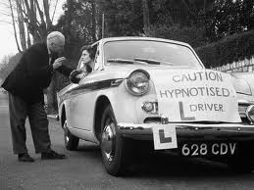
Theories of Hypnosis: Dissociation & The Hidden Observer
Suggests that hypnosis works only on the immediate conscious mind of a person, while a part of that person’s mind (a “hidden observer”) remains aware of what’s going on
Same kind of dissociation that occurs when you drive somewhere familiar and then cant remember how you got there
The conscious part of mind is thinking about something else, while the other part (the hidden observer) is doing the actual driving
In the same way, the hidden part of the mind is aware of the hypnotic subject’s activities and sensations, even though the “hypnotized” part of the mind is unaware

Slide 41
Theories of Hypnosis: Social Role-Playing, Social-Cognitive Explanation
This theory began with an experiment in which participants who were NOT hypnotized were instructed to behave as if they were
They had no trouble copying many actions previously thought to require hypnotic state
Participants who were not familiar with hypnosis, and had no idea what the “role” of a hypnotic subject was supposed to be, could not be hypnotized
Another later study also found that expectancies of the hypnotized person play a big part in how the person responds and what the person does under hypnosis
Social-cognitive theory of hypnosis – assumes that people who are hypnotized are not in an altered state but are merely playing the role expected of them in the situation
People might believe they are hypnotized, but it is actually just a performance, so good that even the “participants” are unaware that they are role-playing
Social roles are very powerful influences on behavior

Slide 42
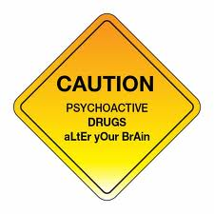
Altered States: The Influence of Psychoactive Drugs
Psychoactive drugs – drugs that alter thinking, perception, and memory
Many psychoactive drugs are very useful and were originally developed to help people
Sedations for surgeries, easing pain, controlling various conditions such as sleep disorders or attention deficits in children and adults
However, when misused these drugs can pose serious risks to one’s health and may even cause death
Potential to create either a physical or psychological dependence, both of which can lead to a lifelong pattern of abuse and the risk of taking increasingly larger doses
Taking larger doses leads to one of the clearest dangers of dependence: a drug overdose

Slide 43
Physical Dependence
Physical Dependence – condition occurring when after using a substance for a period of time a person’s body becomes unable to function normally without the particular drug
Symptoms of physical dependence
Drug tolerance is one sign of physical dependence
As the person continues to use the drug, larger and larger doses are needed to achieve the same initial effects of the drug
Withdrawal is another sign of physical dependence
Physical symptoms that can include headaches, nausea, severe pain, tremors, crankiness, and dangerously high blood pressure, resulting from a lack of an addictive drug in the body systems
These symptoms occur because the body is trying adjust to the absence of the drug
Many users will take more of the drug to alleviate the symptoms of withdrawal
This is an example of negative reinforcement: the tendency to continue a behavior that leads to the removal of or escape from unpleasant circumstances or sensations

Slide 44
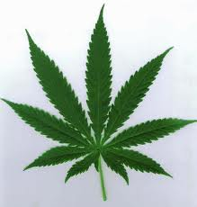
Psychological Dependence
Psychological Dependence – the feeling that a drug is needed to continue a feeling of emotional or psychological well-being
The body physically may not need or crave the drug, and people may not experience the symptoms of physical withdrawal or tolerance, but they continue to use the drug because they think they need it
The rewarding properties of using the drug cause a dependency to develop
This is an example of positive reinforcement: the tendency of a behavior to strengthen when followed by pleasurable consequences
ANY drug can become a focus of psychological dependence
Because there is no withdrawal to go through or recover from, psychological dependencies can last forever
Ex. Some people who gave up smoking marijuana decades ago still say the craving returns every now and then

Slide 45
Types of Drugs
The effect of a particular drug depends on the category to which it belongs and the particular neurotransmitter the drug affects
Categories of drugs
Stimulants – drugs that increase the functioning of the nervous system
Depressants – drugs that decrease the functioning of the nervous system
Narcotics (opioids) – painkilling depressant drugs derived from the opium poppy
Hallucinogenics – drugs that alter perceptions and may cause hallucinations

Slide 46
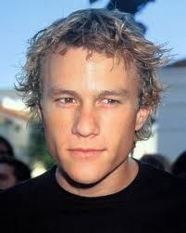
Drug Interactions
Drug interactions are extremely dangerous
Stimulants taken with other stimulants or depressants taken with other depressants, or stimulants with depressants
A single dose in and of itself may not be deadly, but if a stimulant, like amphetamine is taken with another stimulant, like cocane, can result in cardiac arrest
Doses of depressants taken in combination, such as painkillers with antidepressants, can essentially “relax” the body into a coma or death
Ex. Actor Heath Ledger died on January 22, 2010, from an accidental drug interaction, there were 6 different types of depressant drugs found in his system including OxyContin, Vicodin (painkillers), Valium, Xanax (antidepressant/anxiety), Restoril, and Unisom (sleeping pills)

Slide 47
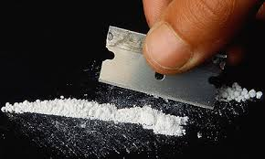
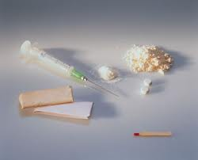
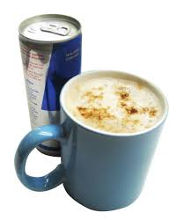
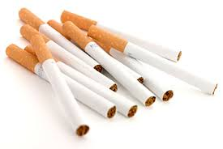
Stimulants
Cause either the sympathetic division or the central nervous system (or both) to increase levels of functioning, at least temporarily
In simple terms, stimulants “speed up” the nervous system
The heart may beat faster and/or the brain may work faster
Types of stimulants
Amphetamines
Cocaine
Nicotine
Caffeine

Slide 48
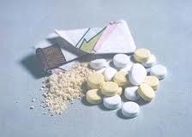
Amphetamines
Stimulants that are synthesized (made) in laboratories rather than being found in nature
Including Benzedrine, Methedrine, Dexedrine, Dextroamphetamine, and Methylphenidate
Some truck drivers use amphetamines to stay awake while driving long hours, and many doctors used to prescribe them as diet pills to over weight people
Sometimes used to treat attention-deficit/hyperactivity disorder (Adderall, Ritalin, Vyvanse)
Like other stimulants, amphetamines cause the sympathetic nervous system to go into overdrive
Don’t give people extra energy but cause people to burn off what energy reserves they do have
They also depress appetite, which is another function of the sympathetic division
When the energy reserves are exhausted, or the drug wears off, a “crash” is inevitable

Slide 49
Amphetamines
When the inevitable “crash” or depression comes, the tendency is to take more pills to get back “up”
This is why people who take amphetamines often develop a physical dependency on the drug and quickly develop a tolerance
The person taking these pills finds that it takes more and more pills to get the same stimulant effect (tolerance)
Doses can easily become toxic and deadly
Nausea, vomiting, high blood pressure, and strokes are possible, as well as a state called “amphetamine psychosis”
A condition that causes addicts to become delusional (losing contact with reality) and paranoid
They think people are out to “get” them and violence is likely, both against the self and others
Amphetamines are also used to treat narcolepsy and are still used as diet pills, but only on a short-term basis and under strict medical supervision
Methamphetamine is a form typically abused by “recreational” drug users
It has powerful effects http://www.youtube.com/watch?v=F8gB-_4-1EE

Slide 50
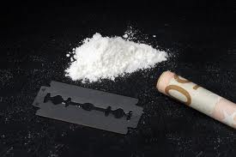
Cocaine
Unlike amphetamines – cocaine is a natural drug found in coca plant leaves
Produces feelings of euphoria, energy, power, and also deadens pain and suppresses the appetite
Was used fairly liberally by both doctors and dentists as a painkiller and numbing agent near the end of the 19th century and beginning of the 20th century, until its addictive and deadly qualities became known
Many patent medicines contained very small traces of cocaine
Including the now famous Coca-Cola (which was originally marketed as a nerve tonic)
However, even in 1902 there wasn’t enough cocaine in a bottle of cola to affect a fly, and all traces were removed by 1929
start at 3 mins http://www.youtube.com/watch?v=KQil-3FFa64

Slide 51
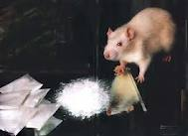
Cocaine
Dangerous not only because it is extremely addictive, but because some people have convulsions and may even die when using cocaine for the first time
Children born to mothers who use cocaine are at increased risk for learning disabilities, delayed language development, and inability to cope adequately with stress, among other symptoms
Laboratory animals have been know to press a lever to give themselves cocaine rather than eating or drinking, even to the point of starvation and death

Slide 52
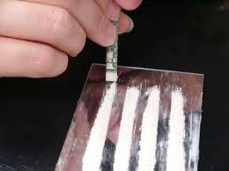
Cocaine
During withdrawal users will experience a severe mood swing into depression (the “crash”), followed by extreme tiredness, nervousness, paranoia, and inability to feel pleasure
The brain is the part of the body that develops the craving for cocaine because of chemical changes caused by the drug
3 basic signs of physical dependency
Compulsive use – if cocaine is available, the dependent person has to use it, he/she cannot say no
Loss of control – those dependent on cocaine can’t stop using it when it’s available until it’s all gone or until they have exhausted themselves to the point where they can no longer function
Disregard for the consequences of use – an addict will lie, cheat, steal, lose their jobs, damage or break up relationships, and use rent money to by cocaine – nothing else matters to them but the drug

Slide 53
Nicotine
Produces addiction in 99% of the people who use it
Every year, nearly 430,000 people in the U.S. die from illnesses related to smoking
That’s more than those who die from car accidents, alcohol, cocaine, heroin and other drug abuse, AIDS, suicide, and homicide combined
Nicotine is a relatively mild but toxic stimulant, producing a slight “rush” or sense of arousal as it raises blood pressure and accelerates the heart, as well as providing a rush of sugar into the bloodstream by stimulating the release of adrenalin
Just like many stimulants, it also has a relaxing effect on most people and seems to reduce stress

Slide 54
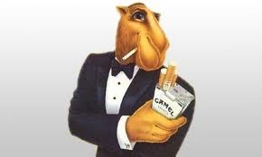
Nicotine
Quitting is difficult for many people
Although there are a lucky few who can quit “cold turkey” without ever smoking again, the majority of people who quit will start smoking again, even after having quit for years
The physical withdrawal symptoms can be as bad as those resulting from alcohol, cocaine, or heroin abuse
Effective “stop smoking” methods involve both education and behavior change
Including contact with a psychologist, physician, or other health-care professional, as well as social support groups
Specific medications help users deal with cravings, such as nicotine-containing gums, lozenges, and patches
Newer medications act on brain regions that cause the person to feel nauseated if nicotine is present in the body (type of operant conditioning)
Combined strategies of counseling and medication work better than either alone

Slide 55
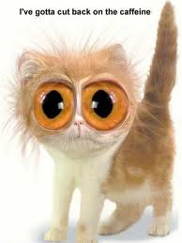
Caffeine
A mild stimulant found in coffee, tea, most sodas, chocolate, and many over the counter drugs
Like cocaine, caffeine is a natural substance and is found in coffee beans, tea leaves, cocoa nuts, and at least 60 other types of plants
Helps maintain alertness, and can increase the effectiveness of some pain relievers such as aspirin
Often added to pain relievers for that reason and is the key ingredient in medications meant to keep people awake

Slide 56
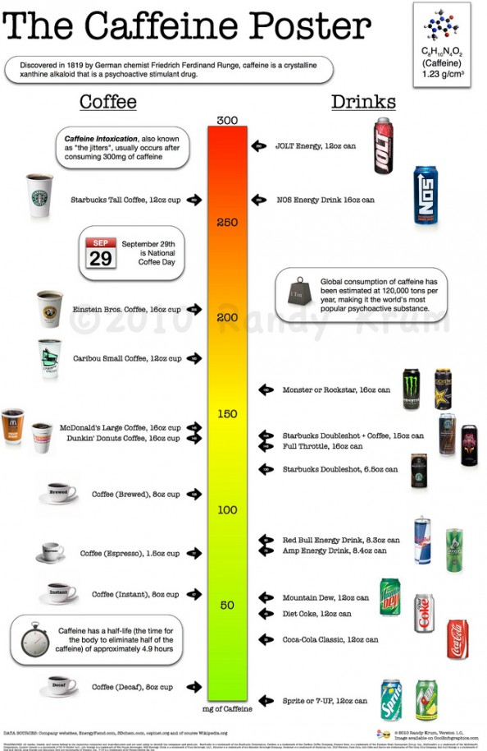

Slide 57
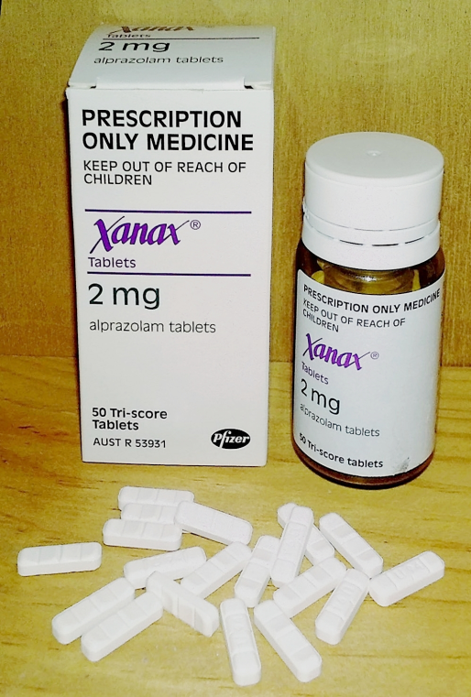
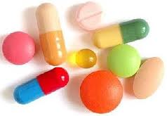
Depressants
Drugs that slow the central nervous system
Barbiturates (major tranquilizers)
Benzodiazepines (minor tranquilizers)
Alcohol

Slide 58
Barbiturates (major tranquilizers)
Drugs that have a strong depressant and sedative (sleep-inducing) effect
Prescribed for treatment of anxiety and insomnia from 1912 to about 1960
During this time they were associated with thousands of suicides, deaths from accidental ingestion, widespread dependency and abuse, and serious interactions with other drugs
Depending on dosage levels, effects range from mild sedation or sleepiness to unconsciousness or coma
Overdoses can lead to death as breathing and heart action are stopped
They are highly addictive and users can quickly develop a tolerance
Withdrawal can be as serious as convulsions, which are life threatening
There is a high risk of drug interaction effects
Even if the dose itself is not fatal, when taken with other depressants drug interactions may cause coma and death (most common interaction is with alcohol)
Examples of barbiturates: phenobarbital (Nembutal), amobarbital (Amytal), and secobarbital (Seconal)

Slide 59
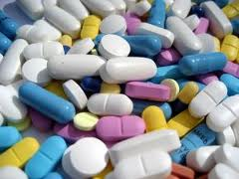
Benzodiazepines (minor tranquilizers)
Have a relatively mild depressant effect
Used to lower anxiety and reduce stress
Considered safer than barbiturates (by morons), and are now the drug of choice to treat sleep problems, nervousness, and anxiety
Most common are Valium, Xanax, Ativan, and Librium
Even these minor tranquilizers can be addictive and large doses can be dangerous, as can an interaction with alcohol with other drugs
Rohypnol is a benzo that has become famous as the “date rape” drug
Usually slipped into a beverage of an unsuspecting person, it causes individuals to be unaware of their actions, although still able to respond to directions or commands
Rape or some other form of sexual assault can then be carried out without fear that the victim will remember it or be able to report it

Slide 60
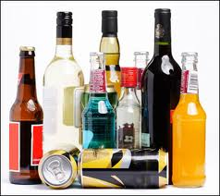
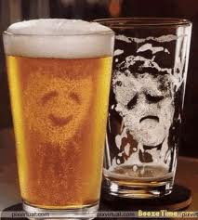
Alcohol
The chemical resulting from fermentation or distillation of various kinds of vegetable matter
Most commonly used and abused depressant
Anywhere from 10 to 20 million people in the U.S. suffer from alcoholism
Aside from the obvious health risks to the liver, brain, and heart, alcohol is associated with loss of work time, loss of a job, and loss of economic stability

Slide 61
Alcohol
Many people are alcoholics but deny it or are unaware
They believe that getting drunk, especially in college, is a ritual of adulthood
Binge drinking (drinking 4-5 drinks within a limited amount of time) quickly leads to drunkenness, which is a major sign of alcoholism
Other danger signs include feeling guilty about drinking, drinking in the morning, drinking to recover from drinking, drinking alone, being sensitive about how much one drinks when others mention it, drinking so much that one does and says things that they later regret, drinking enough to have blackouts or memory loss, drinking too fast, lying about drinking, and drinking enough to pass out

Slide 62
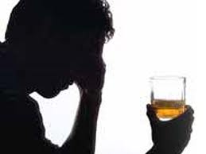
Alcohol
Risk for psychiatric disorders increases from about 2.5% for a light drinker to 13.2% for a moderate drinker and around 17.1% for a heavy drinker
There are numerous disorders that can be caused by alcoholism in addition to liver disease
Korsakoff’s syndrome – a form of dementia brought about by a severe vitamin B1 deficiency, caused by the alcoholic’s tendency to drink rather than eat
Babies born to mothers who drank during pregnancy are likely to be born with a condition of mental retardation and physical deformity called fetal alcohol syndrome
Alcoholism has also been linked to loss of bone density and heart disease

Slide 63
Alcohol
Alcohol is often confused with stimulants
Many people think this is because alcohol makes a person feel “up” and euphoric
In reality alcohol is a depressant that gives the illusion of stimulation because the first thing alcohol depresses is a person’s natural inhibitions
Inhibitions are all the social rules people have learned that allow them to get along with others and function in society
Inhibitions are what keep sober people from taking off their cloths and dancing on a table in a crowded bar… so inhibitions are usually a pretty good thing

Slide 64
Alcohol: How it works
Alcohol indirectly effects the release of the neurotransmitter GABA
GABA is the brain’s major depressant (global inhibitory neurotransmitter)
It slows down or stops neural activity
As more GABA is released, the brain’s functioning actually becomes more and more inhibited, depressed, or slowed down
The areas of the brain that are first affected by alcohol are the areas that control social inhibitions
So, alcohol, due to its stimulation of GABA has the effect of depressing the inhibitions
As the effects continue, motor skills, reaction time, and speech are all affected

Slide 65
Alcohol
Surprisingly, only one drink can have a fairly strong effect
People who are not usually drinkers will feel the effects of alcohol much more quickly than those who have built up a tolerance
Women also feel the effects sooner
Women’s bodies process alcohol differently than men’s bodies do
Women are typically smaller than men, so alcohol has a quicker impact on women

Slide 66
Narcotics (Opiates)
A class of drugs that suppress the sensation of pain by binding to and stimulating the nervous system’s natural receptor sites for endorphins
Endorphins are the neurotransmitters that naturally deaden pain sensations
Because they also slow down the action of the nervous system, drug interactions with alcohol and other depressants can be deadly
All narcotics are a derivative of the plant-based substance opium
Today, the term “narcotics” is inappropriately used to refer to all illegal substances, so scientists don’t use this term any more
More accurate to use the term “opiates” or “opiods”….. But your book apparently doesn’t know this

Slide 67
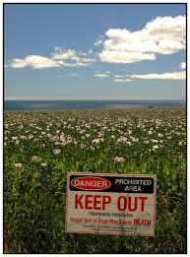
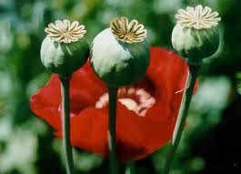
Narcotics: Opium
Opium is made from the opium poppy
Has pain-relieving and euphoria-inducing properties that have been known (and exploited) for at least 2,000 years
Was commonly used by ladies of the Victorian era in a form called laudanum and was still prescribed for teething infants in the middle of the 20th century
It wasn’t until 1803 that opium was developed for use as a medication by a German physician
The new form, called morphine, was called “God’s own medicine”

Slide 68
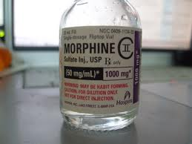
Narcotics: Morphine
Morphine was created by dissolving opium in an acid and then neutralizing the the acid with ammonia
Was thought to be a wonder drug
Although its addictive qualities soon became a major concern to physicians and patients
Is still used today but in carefully controlled doses and for short periods of time
Like after surgeries

Slide 69
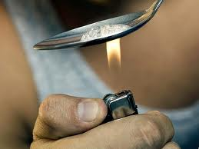
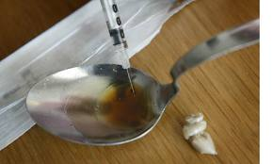
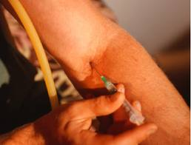
Narcotics: Heroin
Ironically, heroin was first hailed as the new wonder drug as well
A derivative of morphine that did not have many of the disagreeable side effects of morphine
The theory was that heroin was a purer form of the drug, and that impurities in morphine were the substances creating the harmful side effects
It didn’t take long, however, for doctors and others to realize that heroin was even more powerfully addictive than morphine or opium
Although medical use of heroin has stopped, many people still use the drug for recreational purposes

Slide 70
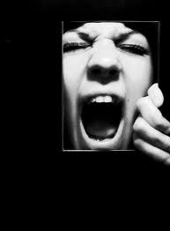
Narcotics: How They Work
Opium and its derivatives, morphine and heroin, duplicate the action of endorphins so well that the nervous system slows or stops its production of the neurotransmitter
When the drug wears off, there is no protection against any kind of pain, causing the severe symptoms of withdrawal associated with these drugs
The addict who ties to quit using these drugs feels such pain that the urge to use again becomes unbearable
http://www.youtube.com/watch?v=Gk-njfY5TKQ&feature=fvwrel

Slide 71
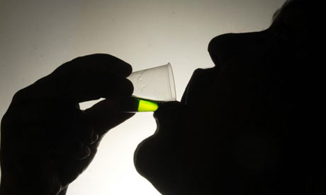
Narcotics: Dealing With Withdrawal
Methadone is a synthetic (manufactured) opioid but does not produce the euphoric “high” of morphine or heroin
Used to control heroin dependency and can be taken only once a day to control the withdrawal symptoms of pain that would otherwise follow when stopping heroin use
2 other drugs, buprenorphine and naltrexone are also used to treat opiate addictions
Eventually as the addict is weaned from these drugs, the natural endorphin system starts to function more normally
This means that one does not have to take these other drugs forever

Slide 72
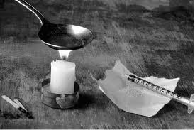
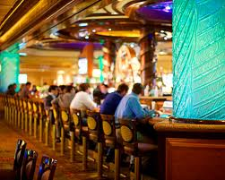
“High Cues”
The “high” of drug use, whether it comes from opiates, stimulants, or depressants often occurs in certain surroundings, with certain people, and even using certain objects, such as the spoons and needles used by heroin addicts
These people, settings, and objects can become cues that are associated with the drug high
So when the cues are present, it may be even harder to resist using the drug because the body and mind have become conditioned to associated drug use with these cues
Form of classical conditioning
Has led to treatments that use behavioral therapies such as contingency-management therapy (operant conditioning strategy), in which patients earn vouchers for negative drug tests
The vouchers can be exchanged for healthier, more desirable items like food

Slide 73
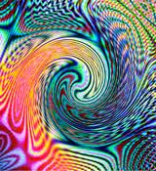
Hallucinogens
Actually cause the brain to alter its interpretation of sensations
Sensations may cross over each other, colors may have sound, sounds may have smells, etc
False sensory perceptions, called hallucinations, are often experienced, especially with the more powerful hallucinogens
There are 2 basic types of hallucinogens
Those manufactured in laboratories
Usually stronger than those from natural sources
Those that are from natural sources

Slide 74
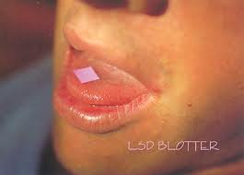
Manufactured Hallucinogens: LSD
Lysergic acid diethylamide (LSD) is synthesized from a grain of fungus called ergot
Ergot fungus commonly grows on rye grain but can be found on other grains as well
First manufactured in 1938
One of the most potent, or powerful, hallucinogens
Only takes a very tiny drop to achieve a “high”
Some people feel that LSD helps them expand their consciousness or awareness of the world, colors seem more intense, sounds are more beautiful, etc.
But, the experience is not always pleasant, just as dreams are not always filled with positive emotions, “bad trips” are very common and there is no way to control what kind of “trip” the brain is going to decide to take
One of the biggest dangers in using LSD is the effect it has on a person’s ability to perceive reality
Real dangers and hazards in the world may go unnoticed by a person “lost” in a LSD fantasy and people may make extremely poor decisions (like trying to drive)
http://www.spike.com/video-clips/wajvol/1000-ways-to-die-bad-assid

Slide 75
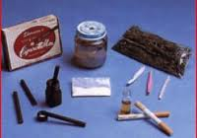
Manufactured Hallucinogens: PCP
Phenyl cyclohexyl piperidine (PCP)
Considered a stimulatory hallucinogen
A drug that produces a mixture of psychomotor stimulant and hallucinogenic effects
Found to be so dangerous that today it is only used as a veterinary medicine as a tranquilizer
Can have many different effects depending on dosage
Can be a hallucinogen, stimulant, depressant, or an analgesic
As with LSD, users of PCP can experience hallucinations, distorted sensations, and very unpleasant effects
PCP can also lead to acts of violence against others or suicide
Users may even injure themselves unintentionally because PCP causes them to feel no warning signal of pain

Slide 76
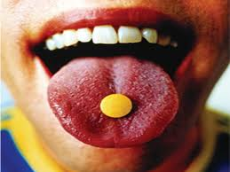
Manufactured Hallucinogens: MDMA (Ecstasy)
Methylenedioxymethamphetamine (similar structure to methamphetamine with additional mescaline)
Considered a stimulatory hallucinogen
Technically an amphetamine but is capable of producing hallucinations as well
One of the properties of MDMA is to dehydrate the body and raise body temperature
So it is very important that someone taking this drug drink enough water
But, excessive drinking of water can also lead to coma and death, as excess fluid can disrupt the salt content of body tissue, making it impossible for all body parts to function properly
As MDMA is a common drug at “raves” (all-night dance parties), night clubs that sponsor raves usually pass out or sell bottled water to offset the dehydration
But many people usually don’t hydrate themselves appropriately because they are caught up in the “high”
Adding to the risk, Ecstasy users who drink alcohol are more likely to have increased dehydration and rise in body temperature

Slide 77
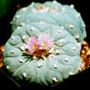
Natural Hallucinogens: Mescaline
Mescaline comes from the buttons found on the peyote cactus
Duration of hallucinogenic effects can last longer than those of LSD
Has long been a part of Native American religious and spirituals
Native Americans have used mescaline in combination with sitting in a hut or other enclosed space while water is poured over very hot rocks
This sauna effect, together with the drug, may produce sensations of being out of one’s body or talking with spirits, which is the purpose of these rituals

Slide 78
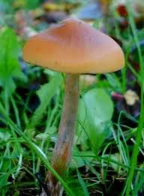
Natural Hallucinogens: Psilocybin
Contained in a certain kind of mushroom
Often referred to as “magic mushrooms” or “shrooms”
Like mescaline, it has also been used in similar rituals by several native cultures
Neither mescaline nor psilocybin has been shown to create physical dependency
But, psychological dependency is possible
Eating psilocybin has been linked to a psychiatric disorder called hallucinogen-persisting perception disorder (HPPD)
Reexperiencing the symptoms of a hallucinogen without actually taking any substances. The disturbance causes marked distress. Complications of this disorder include suicidal behavior, Major Depression, and Panic Disorder

Slide 79
Marijuana
One of the best known and most commonly abused hallucinogenic drugs
Comes from the leaves and flowers of the hemp plant cannabis sative
The most psychoactive cannabinoid, and the active substance in marijuana, is tetrahydrocannabinol (THC)
Marijuana is best known for its ability to produce a feeling of well-being, mild intoxication, and mild sensory distortions or hallucinations
Effects are relatively mild compared to other hallucinogens
In fact, an inexperienced user who doesn’t know what to expect upon first use may feel nothing at all
Most people do report a feeling of mild euphoria and relaxation, along with an altered sense of time and mild visual distortions
Higher doses can lead to hallucinations, delusions, and the all-too-common paranoia

Slide 80
Marijuana
Most studies of marijuana’s effects have concluded that while marijuana can create a powerful psychological dependency, it does not produce physical dependency or physical withdrawal symptoms
However, after alcohol and nicotine, cannabis dependence is the most common form of drug dependence in the U.S., Canada, and Australia
Marijuana negatively affects reaction time and perception of surroundings
Reduces a person’s ability to make split-second decisions, like while driving, are impaired
Information processing in general, attention, and memory are all likely to be impaired

Slide 81
Marijuana
Most commonly smoked like tobacco, but some people have been known to eat it baked into foods
Although no one has ever been known to die from an overdose of marijuana, smoking it is not a healthy habit
Research linking marijuana smoking and lung cancer is not definitive due to the fact that many studies have not been able to control for confounding variables, such as cigarette smoking, alcohol use, or other risk factors
Probable adverse effects from chronic nonmedical marijuana use include increased risk of motor vehicle crashes, chronic bronchitis or other lung problems, and cardiovascular disease
Regular adolescent users can suffer negative impacts on psychosocial development, educational attainment, and mental health
Increased risk for psychotic symptoms and disorders later in life

